Slide 1
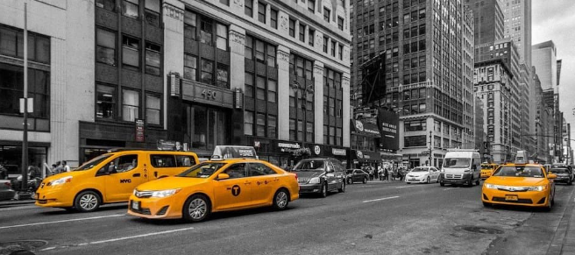

FRAUD DETECTION IN NYC TAXI SERVICES: A DATA SCIENCE APPROACH USING TLC TRIP DATA (JANUARY 2023)
MUHAMMAD KHISANUL FAKHRUDIN AKBAR

Slide 2



INTRODUCTION
The New York City Taxi and Limousine Commission (NYC TLC) is a government agency established in 1971 to regulate commercial transportation services such as taxis, limousines, and ride-hailing apps in NYC. To support oversight, the TLC collaborates with certified technology vendors to record each taxi trip in a structured system known as the TLC Trip Record.
In this industry, fraud can lead to significant financial losses. Therefore, analyzing taxi trip data is essential to identify potentially invalid or unusual trips as part of efforts to detect fraudulent activities.
1

Slide 3

PROBLEM STATMENT
This dataset contains various important information, such as pickup time and location, as well as other supplementary details for each trip. Based on the NYC taxi trip data, there is an indication that some transactions and trips may be invalid or deviate from normal patterns. Therefore, in-depth analysis is required to detect possible fraud in the system. The main problems to be addressed are :
Detecting Travel Abnormality
Distance abnormalities: Are there trips with unreasonable distances?
Duration abnormalities: Are there trips that last too long for short distances or are too fast for long distances?
Fare abnormalities: Are there trips where the fare category is inconsistent?
Anomalies in pickup and drop off patterns
Identifying areas where trips frequently show anomalies.
Identifying specific times when trips frequently show anomalies.
Once abnormalities in trips, areas, and times with high anomaly frequencies are identified, we, as data analysts at NYC TLC, can provide recommendations or solutions to prevent such issues in the future and avoid losses for all parties involved.
2

Slide 4
Executive Summary
The NYC Taxi and Limousine Commission (NYC TLC) maintains trip records to ensure compliance and passenger safety. However, there are indications of fraud, such as manipulated trip distances, durations, and fare pricing, which could result in financial losses for service providers and passengers. Additionally, certain zones and time periods exhibit suspicious travel patterns. To prevent such losses and uphold system integrity, a comprehensive analysis is required to detect and mitigate potential fraudulent activities.
Taxi Demand:
Manhattan recorded the highest taxi activity with 37,352 trips, driven by its role as the city’s business, tourism, and entertainment hub.
Bronx and Staten Island showed very low trip volumes, suggesting limited taxi usage or service accessibility in those boroughs.
High-Anomaly Zones:
Bronx and Staten Island had the highest proportion of suspicious trips (36.27% and 33.33%), despite low total trips, indicating potentially serious anomalies.
Areas like Long Island City/Hunters Point and Queensbridge/Ravenswood in Queens had extremely high anomaly rates (>50%), highlighting the need for focused investigation.
Time-Based Anomaly Trends:
Suspicious trips peaked on weekdays, especially on Tuesday, Wednesday, and Monday, indicating that fraud is more prevalent at the start of the week. Weekends (Saturday and Sunday) had lower anomaly counts, though not entirely free of risk.
The highest anomaly frequency occurred during midday hours (11:00–15:00), followed by spikes during morning rush (06:00–09:00) and a gradual decline in the late afternoon (16:00–18:00). These timeframes align with high traffic and operational pressure.
3

Slide 5
AGENDA
1
2
3
Data Understanding
Taxi Demand
Indication of Fraud
4
5
6
Conclusion & Recommendation
Top Anomaly Location
Anomaly Travel Pattern
4

Slide 6

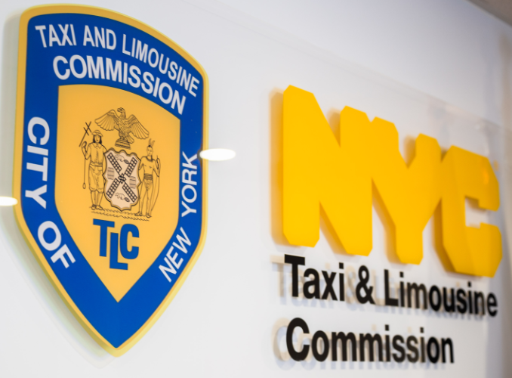
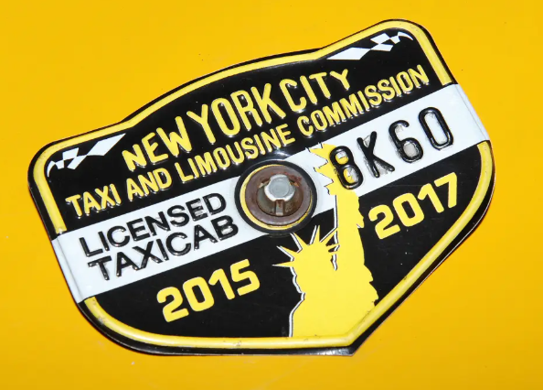
WHAT IS NEW YORK CITY TAXI AND LIMOUSINE COMMISSION (NYC TLC) ?
The New York City Taxi and Limousine Commission (NYC TLC) is a government agency that regulates commercial transportation services such as taxis, limousines, and for-hire vehicles in New York City. Its main duties include
licensing and inspecting vehicles and drivers.
setting fares for taxi and for-hire vehicle services.
protecting consumers from fraud or overcharging,.
promoting accessibility for all individuals.
5

Slide 7
WHERE IS THE DATA SOURCE?
This dataset contains taxi trip data in New York City collected by licensed vendors and periodically submitted to the Taxi and Limousine Commission (TLC). Although published by the TLC, they do not collect the data directly and cannot guarantee its accuracy, as it relies on third-party reports.
6

Slide 8
MANHATTAN LEADS WITH THE HIGHEST DEMAND, DOMINATES WITH 59% OF THE TOTAL TRIPS.
From the bar chart above, it can be seen that the borough with the highest taxi demand in January 2023 is Manhattan, with a total of 37,352 trips, accounting for 59% of the total trips in the dataset (63,182).
7

Slide 9
NYC HAS A TOTAL OF 220 ZONES. EAST HARLEM NORTH IS THE MOST IN-DEMAND ZONE, WITH 20.45% OF TOTAL TRIPS
20.45%
NYC has a total of 217 Zones, Zone is an administrative area that is below the level of a borough. East Harlem North is the most in-demand zone, having 12,921 trips and a share of 20.45% of 100% taxi demand in New York City. From this we can also conclude that the zones with the highest demand are mostly in Manhattan and there is one zone in position 3 which is in Queens, namely Forest Hills.
13.97%
6%
5.89%
5.68%
8

Slide 10
SUSPICIOUS TRIP PREVIEW
With a total of 60,160 trips spread across 220 zones in NYC, 5% of them or 3,022 trips were indicated as suspicious travels. This result was obtained by taking into account three factors namely Distance abnormalities, Time Travel abnormalities, and Fare abnormalities.
9

Slide 11
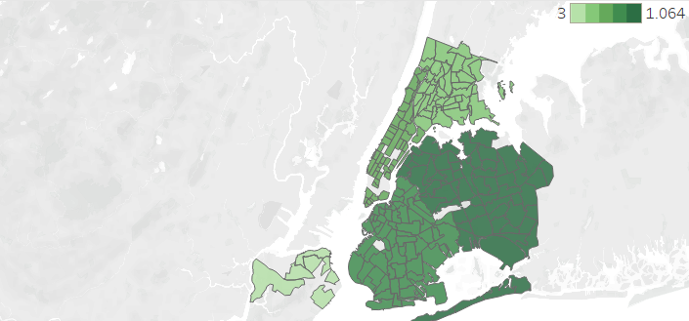
There were 2722 trips that recorded a distance of 0 miles or about 4.31% of the total trips, even though there were trip durations. This could indicate a Unusual Trip Distance.
UNUSUAL TRIP DISTANCE BY BOROUGH
10

Slide 12
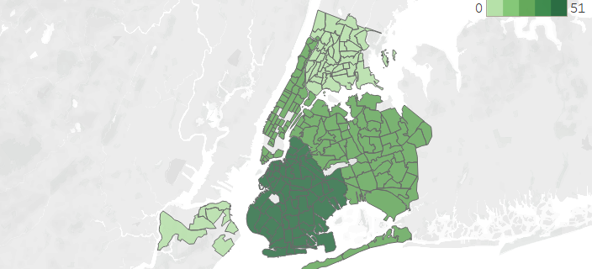
There were 111 trips or about 0.17% of the total trips, indicating Unusual Time Travel.
With indications of Travel too fast (<10 seconds for 5+ miles) or Travel too slow ( 1+ hour for <0.5 miles).
UNUSUAL TIME TRAVEL BY BOROUGH
11

Slide 13
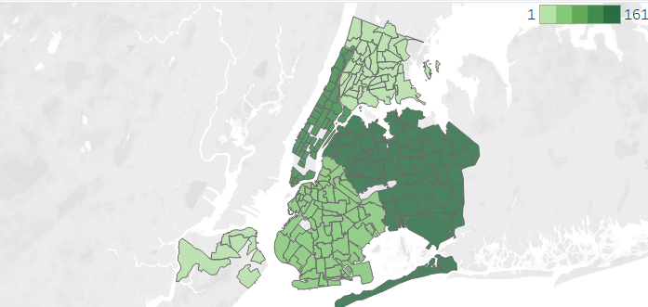
There were 317 trips or about 0.5% of the total trips, indicating Unusual Rate Code Fee.
With indications of trips that do not match the fare, in pick-up and drop-off locations.
Rate Code | Description
1 – Standard Rate | Standard rates within NYC city limits (5 boroughs)
2 – JFK | Fixed fare to/from JFK Airport and Manhattan.
3 – Newark | Travel from/to Newark Airport (EWR).
4 – Nassau/Westchester | Travel out of NYC to Nassau or Westchester counties.
5 – Negotiated Fare | Pre-agreed rates, usually for specific trips or specialized services.
6 – Group Ride | Special fares for group rides on certain routes.
UNUSUAL RATE CODE FEE BY BOROUGH
12

Slide 14
With 1,218 cases, Queens has become the center of suspicious travel.
Queens became the borough with the highest number of cases, far surpassing the others. A possible reason for this is its proximity to JFK Airport and LaGuardia Airport, which may increase the risk of fraudulent activities or unclear travel patterns. Additionally, Queens has extensive industrial, commercial, and residential areas, resulting in more diverse travel activities.
3,022 Total Cases
5% From Total Trips
13

Slide 15
Bronx and Staten Island have the highest proportions of suspicious trips
Queens has the highest number of suspicious trip cases in absolute terms, but the lowest proportion due to its large trip volume. In contrast, the Bronx and Staten Island show higher anomaly proportions despite having fewer cases, indicating a greater level of irregularity in areas with lower trip volumes.
14

Slide 16
East Harlem North (Manhattan) is the highest abnormality zone, with 223 suspicious trips.
Out of a total of 3,022 cases across 217 zones, the top five suspicious travel zones are concentrated in Manhattan and Queens. East Harlem North (Manhattan) ranks highest with 223 cases, followed by Astoria (176), East Harlem South (170), Queensbridge (148), and Forest Hills (127). This indicates a high concentration of suspicious activity particularly in the Manhattan area.
217 Total Zones
3,022 Total Cases
15

Slide 17
Long island City (Queens) have the highest proportions of suspicious trips
Long Island City and Queensbridge stand out with the highest proportions of suspicious travel, at 63.83% and 56.49% respectively, indicating high risk despite potentially lower overall demand. In contrast, areas like East Harlem North and South show high absolute case numbers but very low suspicious proportions (below 2%)
16

Slide 18
SUSPICIOUS FREQUENCY PER DAY
Anomalies peak on Tuesday (519), likely due to increased business, deliveries, and transportation activity. On weekends, anomalies are lower but still significant, with Saturday (349) and Sunday (365), likely driven by recreational, social, and tourism-related activities.
Statistical test results show a significant difference in the average number of suspicious trips between weekdays and weekends (p-value 0.0188 < 0.05), indicating the need for further monitoring during high-risk periods by service providers like NYC TLC to prevent fraud and enhance trust in transportation services..
17

Slide 19
TREND BASED ON TIME
Anomalies peak between 11:00 - 15:00 due to high midday activity, then decline after 15:00 as travel stabilizes. Midnight to early morning (00:00 - 05:00) sees low anomalies, likely linked to nightlife transport and night shift workers, with a sharp drop at dawn (05:00 - 06:00) due to minimal traffic. Critical periods include morning rush (07:00 - 09:00) with increased work and school commutes, and afternoon/evening (16:00 - 18:00) with a gradual decline as people return home.
18

Slide 20
CONCLUSION & RECOMMENDATION
To improve transportation efficiency, it is necessary to optimize taxi pickup and drop-off points, especially in business centers, tourist areas, like East Harlem North and East Harlem South Zones
Manhattan has the highest number of trips, totaling 37,352, far surpassing other boroughs.
Queens has the highest number of suspicious trips overall, while Bronx and Staten Island show higher anomaly proportions despite low trip volume
Focus fraud detection efforts in the Bronx and Staten Island through targeted inspections, while improving monitoring in high-volume areas like Queens
19

Slide 21
CONCLUSION & RECOMMENDATION
Extremely high proportion of suspicious trips in specific zones (>50%), such as Long Island City and Queensbridge
Install CCTV and monitoring sensors, and deploy field inspection teams in high-risk zones to detect and prevent potential fraud by drivers.
Implement time-based anomaly tracking and allocate enforcement resources dynamically across weekdays and weekends based on anomaly trends.
Anomalies peak on weekdays (especially Tuesday), but remain significant on weekends.
20

Slide 22
THANK YOU
As a regulator, NYC TLC needs to strengthen its role in ensuring data quality by establishing an internal data unit and building a fraud detection system to accurately identify suspicious trips and ensure the data collected is more valid.

Slide 23
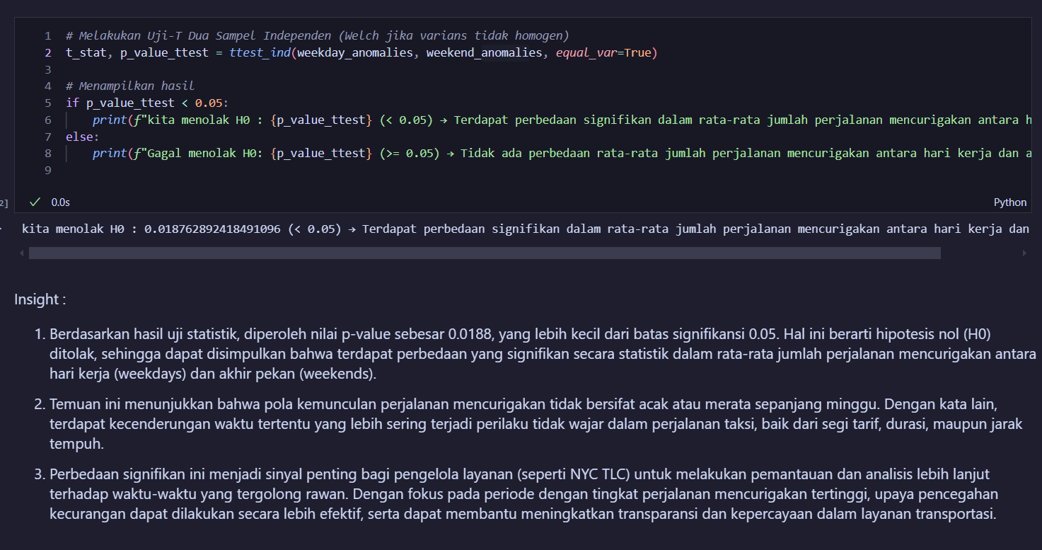
APPENDIX

